Slide 1


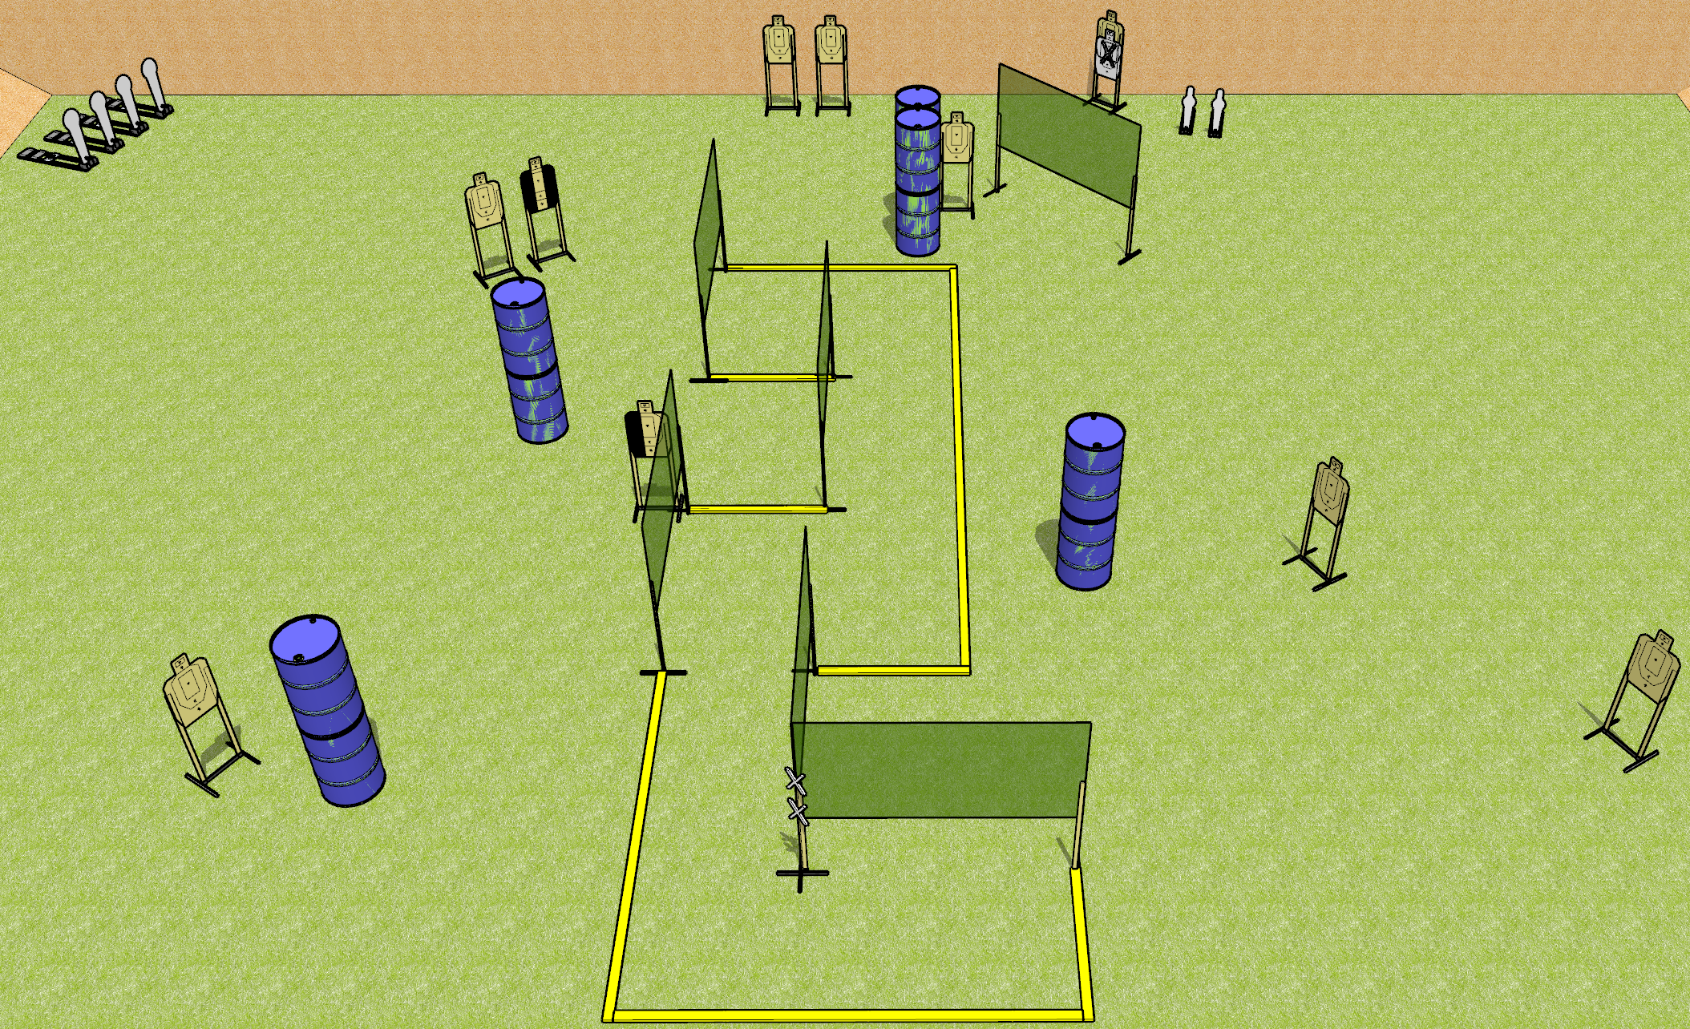
 | Dothan Gun Club – USPSA Match Keyway Course Designer : Drew Coleman
Round Count 10 USPSA targets 4 colt poppers, 2 mini poppers
Equipment List 11 wall feet 4 medium fault lines 1 tuxedo, 1 left hard cover

Slide 2
Keyway
Written Stage Briefing
Keyway is a 26 round, 130 point, Comstock course of fire. There are 10 USPSA targets, 4 colt poppers, and 2 mini poppers. The best 2 hits on paper will score and steel must fall to score. The start signal is audible.
Handgun start position is both hands touching marks. Handgun is loaded and holstered.
PCC start position is muzzle touching lower mark. Loaded carbine is held with both hands.
On start signal, engage targets as they become available from within the shooting area.

